Slide 1
Online Examination Portal
Team member
Adarsh
Akash
Faiz

Slide 2
Introduction
Online examinations are an important method of evaluating the success potential of students. This research effort the individuals under consideration were students who would be enrolling in computer courses or Technologies Registrations. A prototype of a web-based placement examination system is described from the standpoint of the research effort, end user, and software development.

Slide 3
Analysis
1.1 System Analysis
1.2 System Specification

Slide 4
1.1 System Analysis
Existing System:
Existing system is a manual one in which users are maintaining books to store the information like Student Details, Instructor Details, Schedule Details and feedbacks about students who attempted exam as per schedule.. It is very difficult to maintain historical data.
Disadvantages:
Lots of copies of questions have to be made, lots of corrections, hence delays the result time and last is lots of tabulation for each subject

Slide 5
1.2 System Specifications
Hardware Requirements:
Pentium 4(processor)
256mb RAM
512 kb cache memory
Hard disk 10 GB
Microsoft Compatibility
Software Requirements:
OS : Windows
Web technology : PHP
Front End : HTML, CSS, JavaScript
Back End : MySQL
Web Server : Apache Server

Slide 6
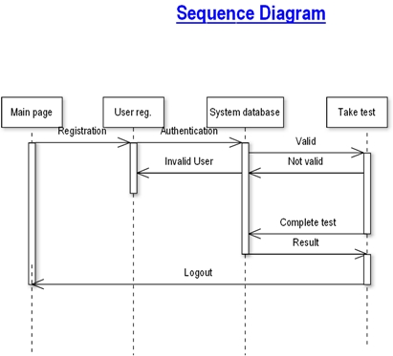
How it works!

Slide 7
Modules in portal
There will be three types of modules in this system:
Student Module
Teacher Module
Admin Module

Slide 8
Student’s module
This module contain:
Registration : To authenticate first you have to be registered.
Login : Registered user need to authenticate to see the inner details.
Take Exam : Multiple Choice Question(MCQS), True/ False. Where student is required to take the examination
Result of Exam : Can see the result after examination.
Logout : Logout the authentication after examination or some work.

Slide 9
Teacher’s Panel
1.REGISTER : To be authenticated first have to be registered.
2.LOGIN : The Registered User Can be Allowed to view inner details for which he Permitted
3.CHANGE PASSWORD : User has rights to modify his logging details& also be informed through mails if he is unable to login
4.ADD QUESTIONS-DEPARTMENTS VERIFING : According to flow of questions & Technology he can add questions into the database.
5.UPDATE QUESTIONS -DEPARTMENTS VERIFING : If any corrections in data of questions he can modify them
6.CREATE EXAMS : He will be prepared schedule for exams periodically.
7.UPDATE EXAMS : He has rights to modify exam schedule.
8.VIEW EXAM DETAILS : VIEW NO OF REGISTERED STUDENTS, VIEW NO OF ATTENDED STUDENTS
9.EVALUATE QUESTION:MULTIPLE CHOICE TRUE/FALSE : Evaluation of marks based on his initiations when adding questions.

Slide 10
Admin Panel
1.REGISTER : To be authenticated first have to be registered.
2.LOGIN : The Registered User Can be Allowed to view inner details for which he Permitted
3.CHANGE PASSWORD : User has rights to modify his login details & also be informed through mails if he is unable to login.
4.STUDENT -MODIFING DETAILS : User can be modified to change status of each User.
5.DEPARTMENTS-ENTERING/MODIFYING DETAILS : New departments adding and old department deletions are spend by this user
6.INSTRUCTOR DETAILS-MODIFYING DETAILS : According to staff he can add or delete Instructors for specific platforms.

Slide 11

Adding Machine learning Concept
The Project consist of analysis of results from the score.
KNN(k-Nearest Neighbour) can be best algorithm for this analysis.

Slide 12
K-Nearest neighbour
K nearest neighbours is a simple algorithm that stores all available cases and classifies new cases based on a similarity measure (e.g., distance functions). KNN has been used in statistical estimation and pattern recognition already in the beginning of 1970's as a non-parametric technique.

Slide 13
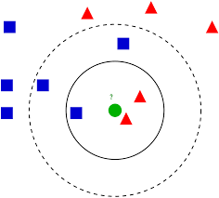
More on knn algorithm
The k-nearest neighbours (KNN) algorithm is a simple, supervised machine learning algorithm that can be used to solve both classification and regression problems. It's easy to implement and understand, but has a major drawback of becoming significantly slows as the size of that data in use grows.

Slide 14
Use of ML in our project
For Report Analysis
For Web Proctored using Face Recognition System

Slide 15
Face Recognition System
This will help us to detect the authenticity of the person
Will help in real time check of person whether he/she is sitting in the examination of not
Help use in detecting the person whether he/she is trying to cheat or not.

Slide 16
Future plans
Adding the Non changeable page to make sure the user cannot see from other windows
Integration of audio and video to increase the protection from cheating
Integration of adding the force close of all the apps through command prompt to make sure that the services which we are running in background should not interrupt the test and student.

